Slide 1

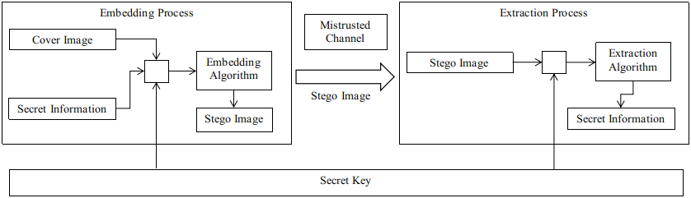
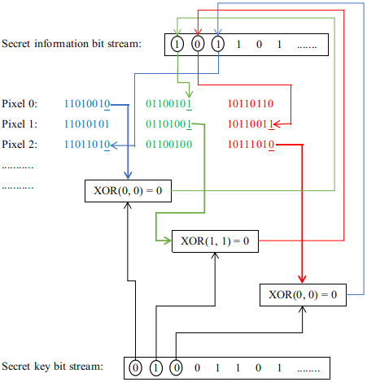
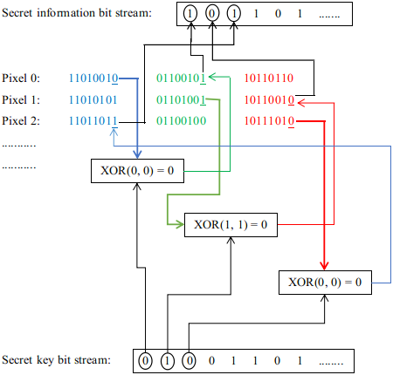
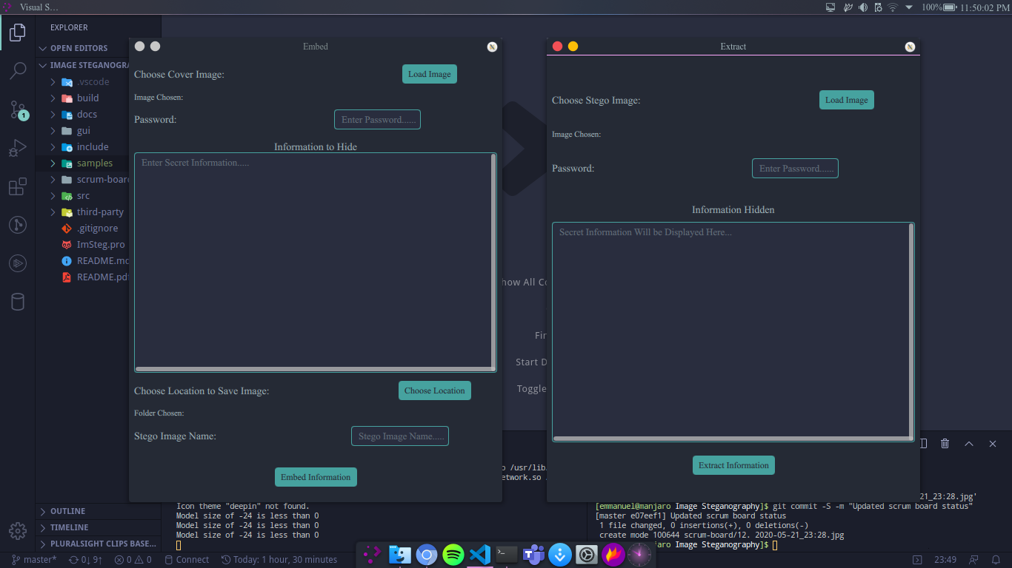
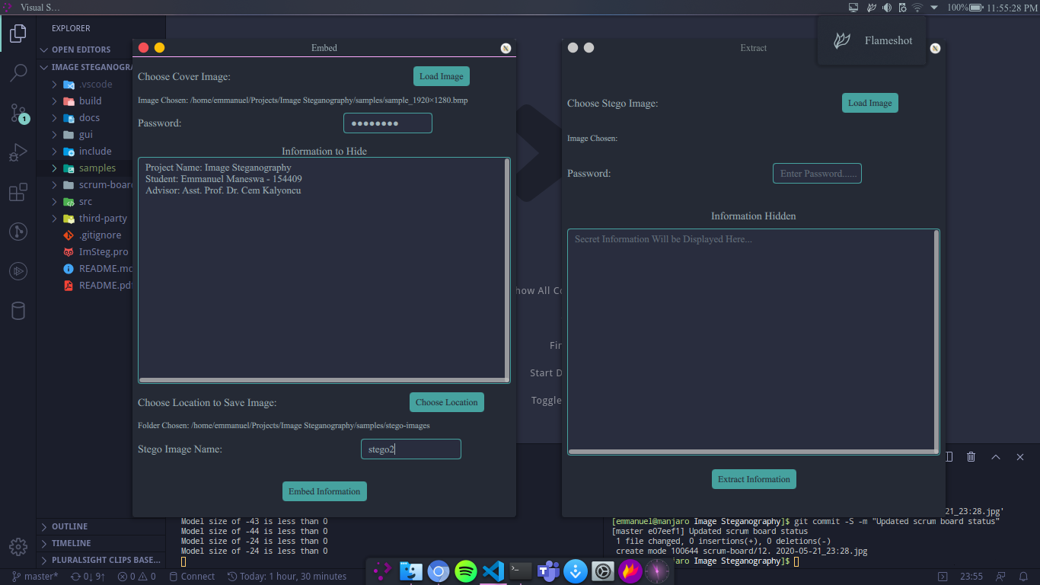
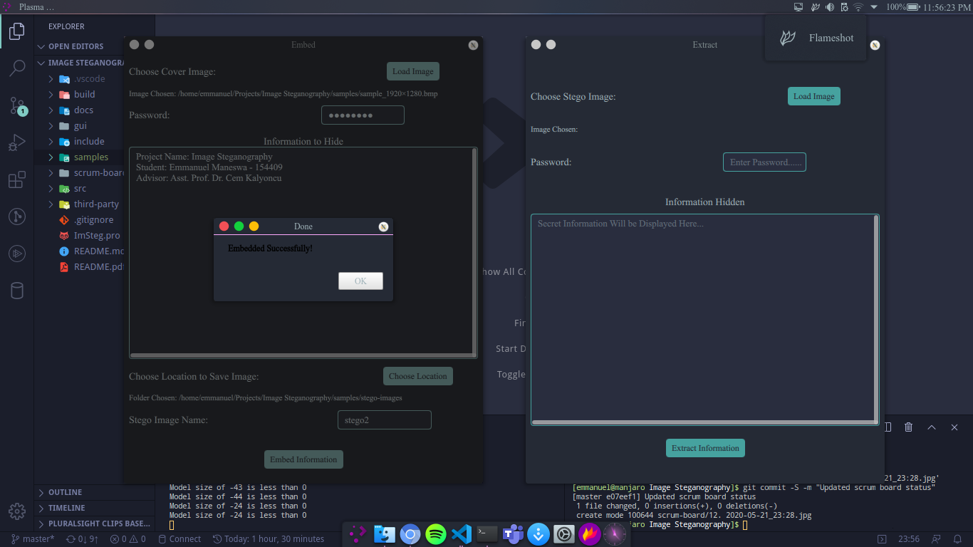
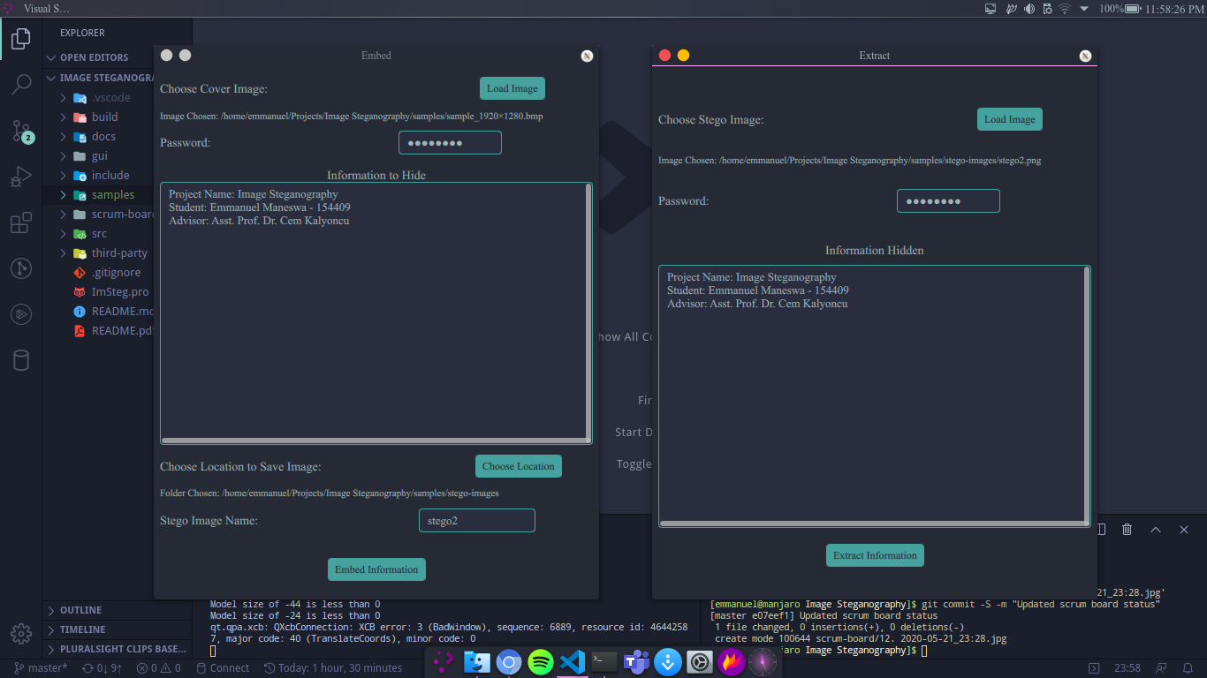
IMAGE STEGANOGRAPHY Emmanuel Maneswa Asst. Prof. Dr. Cem Kalyoncu European University of Lefke, Engineering Faculty, Lefke, T.R.N.C
Introduction
Conclusions
Steganography is the art of concealing information within other non-secret data.
With increase in computational power everyday I think encryption is becoming obsolete and attacks on encrypted data have increased.
Even with the rise in computational power if we turn to steganography the attacks might be minimized because the attacker might no be able to distinguish between a normal image and an image containing sensitive data.
Sensitive data might be system passwords or keys, etc.
The main benefit of this project is when you try to compare it to Cryptography. The Cryptography and Steganography are the two different aspect of the same situation. Cryptography encrypts the message make it complex whereas Steganography hides traces of the message. text would go here.
In the proposed technique of this project I added a secret key into the basic concept of the LSB algorithm. This secret key is beneficial to make message hidden much more difficult to extract without the secret key.
In the proposed method, since I use only the LSB of one color per pixel, The changes done to the image are kept to a minimum amount. This gives the stego-image a lower distortion.
Methods & Materials
Acknowledgments
For my project, I introduced a secret key so that I can protect the secret information. I take the binary representation of the encrypted secret information and then modify some of the LSB of one byte per pixel inside the cover image. In this method, I used the following formula:
Encrypted Secret Information + Secret Key + Cover Image = Stego Image
C++, JavaScript, QML
I would like to express my gratitude to my project supervisor, Assist. Prof. Dr. Cem B. Kalyoncu, who guided me throughout this project. I would also like to thank my advisor, Assist. Prof. Dr. Ferhun Yorgancıoğlu, for the continuous support of my BSc study and his motivation. I would also like to thank my family and friends who supported me.
Contact Details
+90 533 861 6082
emmanuelmaneswa@gmail.com

